Slide 1
Individualised and Community - engaged Support Services
The Change Implications for Organisation Systems and Structures

Slide 2
The Agenda
Individualised and Community – Engaged: – The Context and Meaning
The Potential Scale and Scope of Change for Service Providers
Individualised Resource Allocation – System Requirements
The HRM Changes Required
Change Management Challenge – How Soon Should We Start?

Slide 3
Individualised and Community –Engaged Means...
P2:Ensures the involvement of service users in all decisions that affect them, providing support for informed decision making, and facilitating service users to exercise control over and direct the supports that they receive.
P3:Provides services and supports that are effective in meeting the explicit needs, wishes and choices of each individual service user.
P6:Maximises the participation of service users in the ordinary life of the community, and supports active citizenship and the development of valued social roles.
P7:Supports people in the local communities in which they live; where the community resources and facilities available to them are located; and where relationships and natural supports are most relevant to the quality of their daily lives.

Slide 4
We Are not Starting from Scratch..
New Venture - North Tyneside 1988 [A personal reflection]
Experience in UK, US,
Experience here in Ireland
Reality: Many organisations are not in a Greenfield situation
“If that is where you are going, then I wouldn’t start from here” - Kerryman giving directions to a tourist
Organisation Design Maxim: “Form follows function”

Slide 5
Reality: Many organisations are not in a Greenfield situation ..
“If that is where you want to go, then I wouldn’t start from here” - Kerryman giving directions to a tourist
Organisation Design Maxim: “Form follows function”

Slide 6
Individualised and Community –Engaged –the Context
Changing service context
External Standard -setting and Evaluation
DOHC Policy Principles: individualisation of Service s & Resource Allocation
Person - Centred Service Models
Rights - based
Entitlements

Slide 7
Services Promoting Valued Accomplishments
The Five Valued Accomplishments | Support Services Contribute through..
Making Choices Growing in Relationships Being accorded Dignity and Respect Sharing Ordinary Places Making a Contribution | Promoting individual choice Promoting & supporting social and community participation Encouraging valued social roles Supporting the individual to have a community presence Supporting the individual to make a meaningful contribution in society

Slide 8
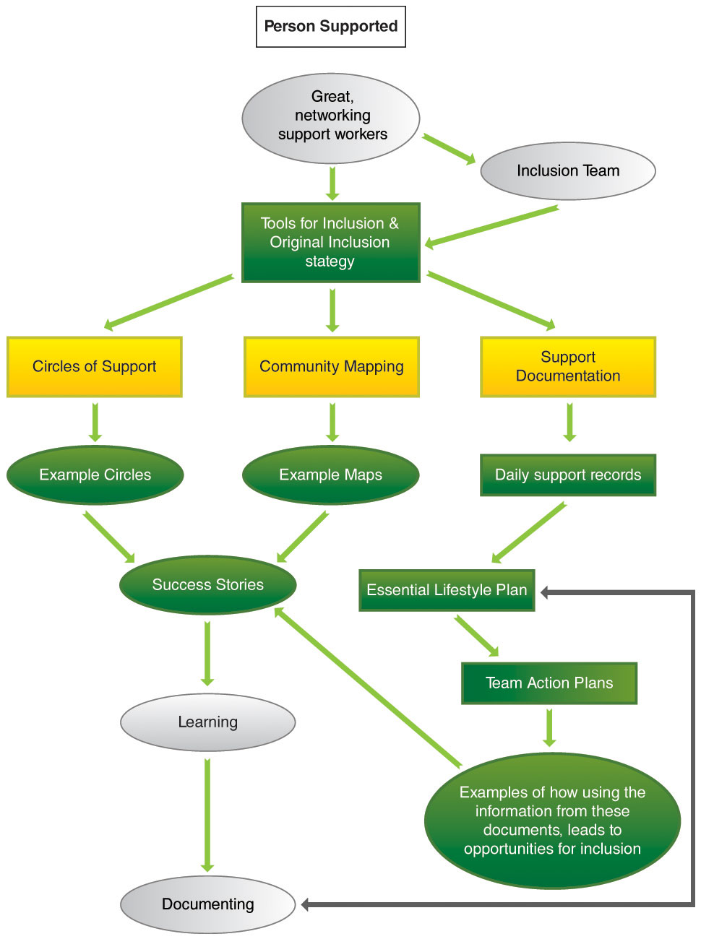

Slide 9
The Potential Scale and Scope of Change Required...
From... | To...
Monopoly Providers | Competitive Market
Fitting individual into the Service | Shaping the service around the individual
Set Service Menus | Flexible and Diverse Supports - Innovation
“Profession”– dominated Delivery | Community – enabled Delivery
Direct Service Delivery as Primary Activity | Facilitation and Coordination of Support Activity
Block Resource Allocation | Individualised and Itemised Resourcing
Rationing and Waiting Lists | Equitable Allocation based on Entitlement
Payment for Inputs | Payment for Outcomes
Inward looking Quality Assurance | 360 - degree Quality Assurance

Slide 10
Individualised Funding- Necessary Elements 1.
An Effective Resource Allocation System [RAS]
Accurate and objective assessment of need
Facilitation of informed choice
Schedule matching need status with resources support
Continuum of options for to Whom and How the resource is allocated

Slide 11
Individualised Funding- Necessary Elements 2.
Facilitation by real – time MIS – IT
Individual service – user access to a DIY portal and Options menu
Commissioner’s field for standards specification
Commissioner & supplier portal for tendering
Service provider’s field for registering
Service providers field for activity and outcome recording
Commissioner’s tool for activity and schedule tracking
Commissioner’s tool for budgets, resourcing & activity consolidation
Evaluation raw data consolidation database [contracting, activity, outcomes, resourcing and expenditure]

Slide 12
Individualised Funding- Necessary Elements 3.
Governance and Safeguards Systems & Protocols
Objective – 3rd – party oversight
Appeals Mechanism
Is the funding being used for the right purposes?
Inspection system
Quality Assurance & Quality Improvement
Evaluation system

Slide 13
Necessary Elements 4. A service Evaluation Process that is Learning – Focussed
= 360° Service Evaluation!
Service User Outcomes What difference has this made? | 2. Service “Best Value” How efficiently has this been done?
4. Quality Improvement Process What are we learning about how to do it better? | 3. Customer Feedback What is my view as customer?
360 Service Evaluation Process ©TPP

Slide 14
The HRM Implications are wide – reaching...

Slide 15
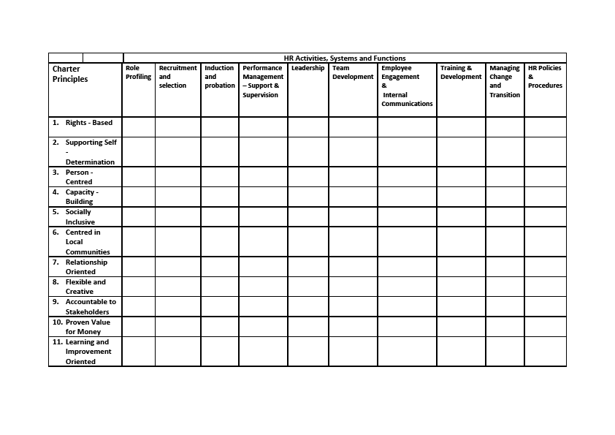

Slide 16
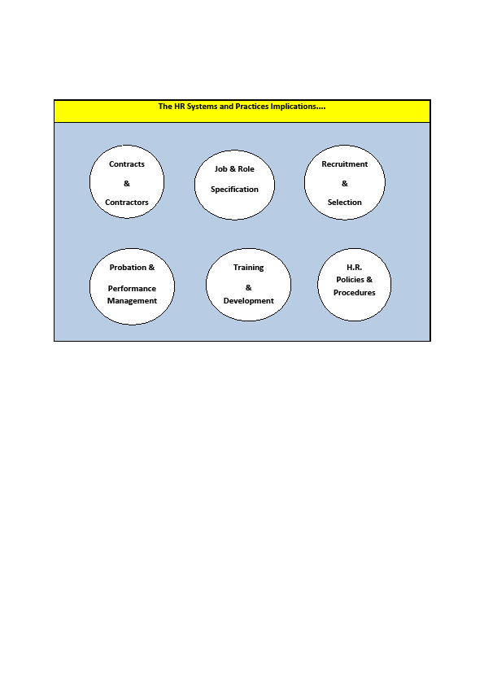

Slide 17
Modelling the HR Change Elements 1.
Example 1 : Staffing configuration
From: primarily direct service provider in specific role mainly in own organisation settings
To: more flexible support and activity facilitation across a range of community settings
Requires Change in?: Role profile & skillmix – person specification – deployment model - recruitment – training & development – performance management

Slide 18
Modelling the HR Change Elements 2.
Example 2 : Contracting
From: Employment by Service Organisation on a Career Basis
To: Contracting by Consumer on an “as needed” basis
Requires Change in?
Contract types - terms and conditions – accountability relationships - matching worker to customer

Slide 19
Modelling the HR Change Elements 3.
Example 3 : “Customer is King”
From: HR practices run totally by Service Organisation
To: Active role of customer in decision making
Requires Change in?
Inclusive recruitment – inclusive selection practices – inclusive induction & training - inclusive performance evaluation

Slide 20
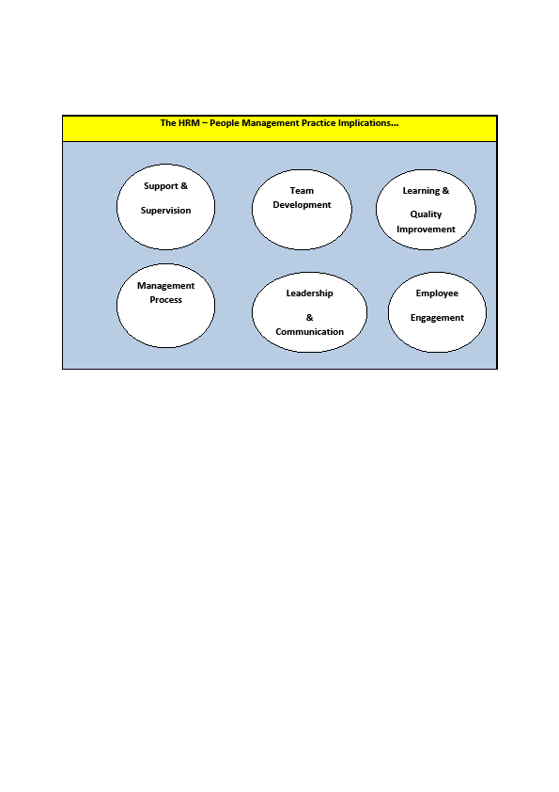

Slide 22
Modelling the HRM Change Elements 1.
Example 1 : Team – based performance model
From: Team formally managed by team leader / manager
To: Network of support facilitated & enabled to act as a “team”
Requires Change in?
Our approach to teamwork – team development process – communication – distributed power vs formal power

Slide 23
The Change Management Imperative 1
3 Cardinal rules of effective organisation development
Rule 1: Form follows Function
Rule2: Execution eats strategy for breakfast
Rule 3: Participative change processes generally lead to more sustainable results

Slide 24
The Change Management Imperative 2
Organisation Form follows Function
X PCP? !??

Slide 25
Change Management 3.

Slide 26
Change Management 4 – How Soon do we need to Get Ready?
? NOW!
Model It
Learn from Others...Visit
Pilot it..
Develop Options
Involve a different and wider group of people

