Slide 1
IRN STEERING COMMITTEE ROLES
February 2017

Slide 2
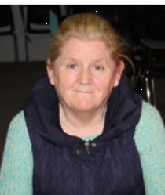
IRN Steering Committee
Chair - Nancy Leddin
Vice Chair—Joan Body
Secretary—Brian Donohoe
Public Relations Officer—Fionn Angus
Treasurer – Laura

Slide 3
Role of Steering Committee
Chair
Chair IRN monthly meetings
Chair monthly planning meeting
Decide meeting agenda with Steering Committee
Help prepare IRN presentations
Sign off on all IRN presentations
Keep time at meetings
Follow up between meetings as needed
Welcome people at meetings
A.O.B (Any Other Business)
Make Final Decision if a vote ends in a tie
Vice Chair
Stand in for Chair as needed
Attend monthly planning meetings
Help Chair prepare for meetings
Help prepare presentations
Attend all IRN meetings
Make presentations for IRN

Slide 4
Role of Steering Committee
Public Relations Officer
Attend monthly planning meetings
Attend monthly IRN meetings
Do talks at conferences
Arrange media interviews
Call press conference
Prepare press releases
Tell people about IRN work
Advertise upcoming events

Slide 5
Role of Steering Committee
Secretary
Organise monthly meeting and planning meetings
Send out emails to all IRN members about the meetings
Follow up with any emails received from members
Attend monthly IRN meetings
Do talks at conferences
Take notes at meetings
Send IRN members copies of minutes and agenda.

Slide 6
Treasurer
Sign cheques and pay bills
Keep track of budget
Prepare an annual budget report
Update budget at each meeting
Look for grant funding

